Slide 1



WoT Meetup
WoT Digital Twin Ontology (WoTDT)
Ontology Engineering Group,
Universidad Politécnica de Madrid
Salvador González-Gerpe, Andrea Cimmino,
Raúl García-Castro
salvador.gonzalez.gerpe@upm.es
05/2024
Notes:
Representing Digital Twins and their information resources with WoT

Slide 2
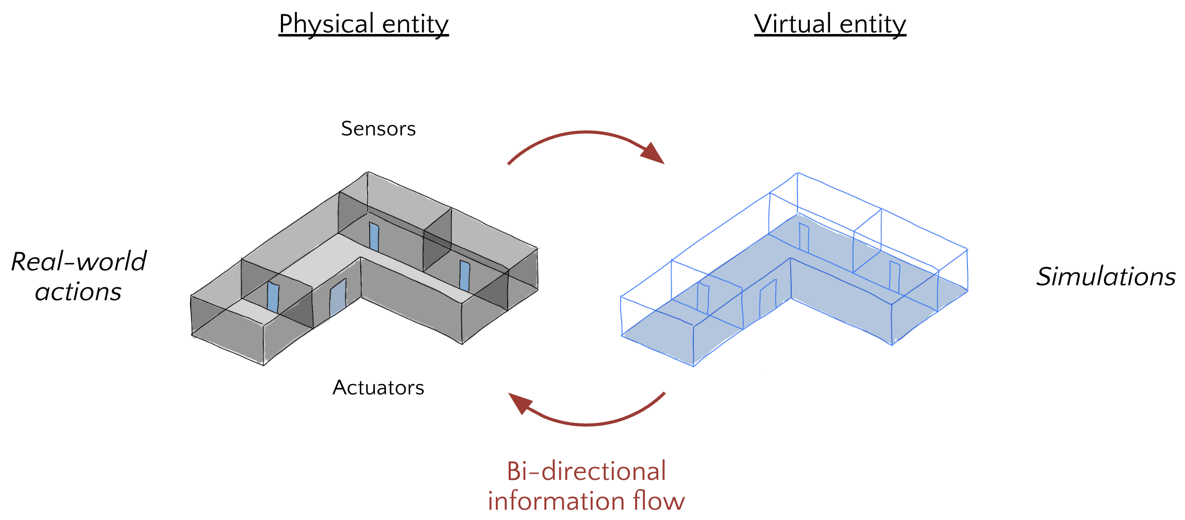
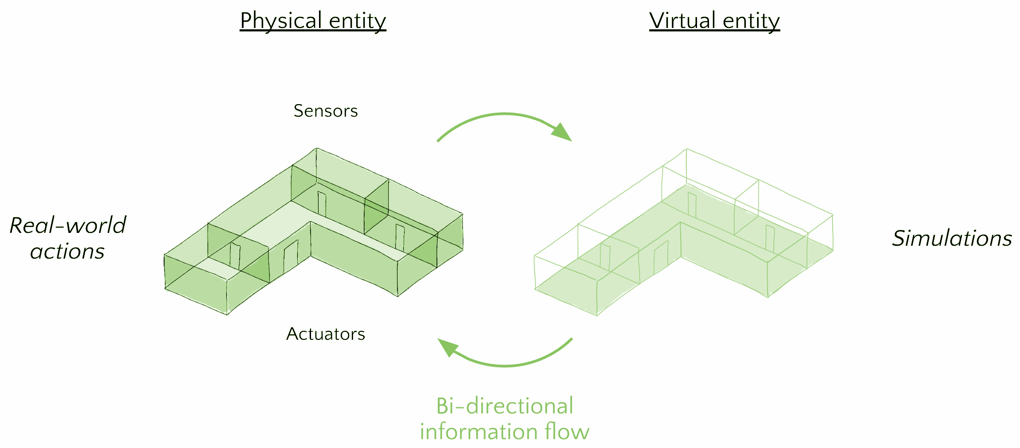
What are Digital Twins?
Real-World Entity
Digital Entity

Slide 3
What are Digital Twins?
Real-World Entity
Digital Entity
Models
Sources of Data
Data
Services

Slide 4
Digital Twin five-dimensional architecture
Real-World Entity
Digital Entity
VirtualEntity *
Entity *
Models
DT Connections *
Sources of Data
Data
Services
DT Services *
DT Data *
* Tao, F., Zhang, M., Liu, Y., & Nee, A. Y. (2018). Digital twin driven prognostics and health management for complex equipment. Cirp Annals, 67(1), 169-172.
Notes:
data sources en un bocadillo y los models,data y services también, flechas entre las cajas de la derecha para relacionarlos
raw data vs harmonized data?

Slide 5
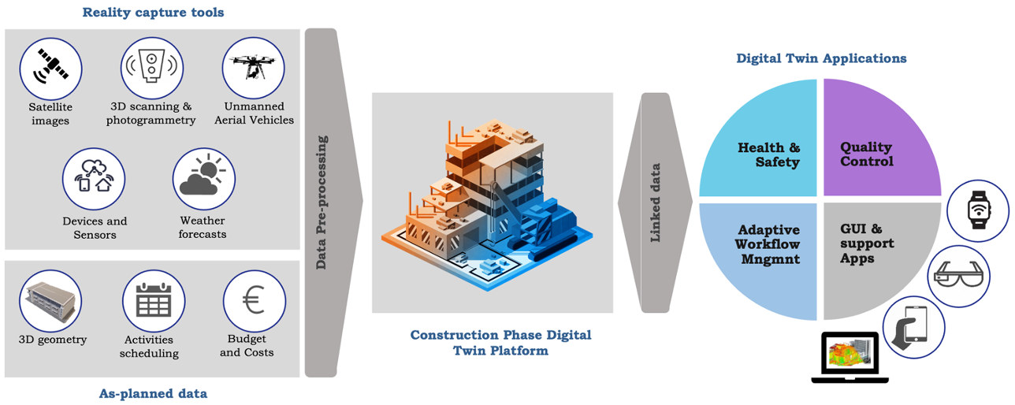
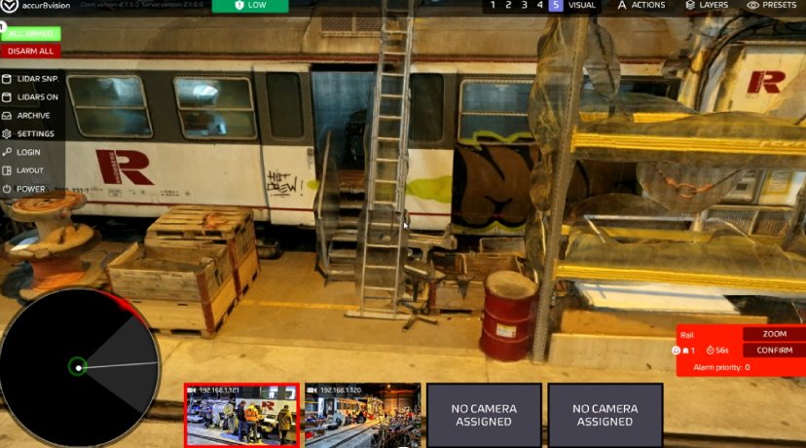
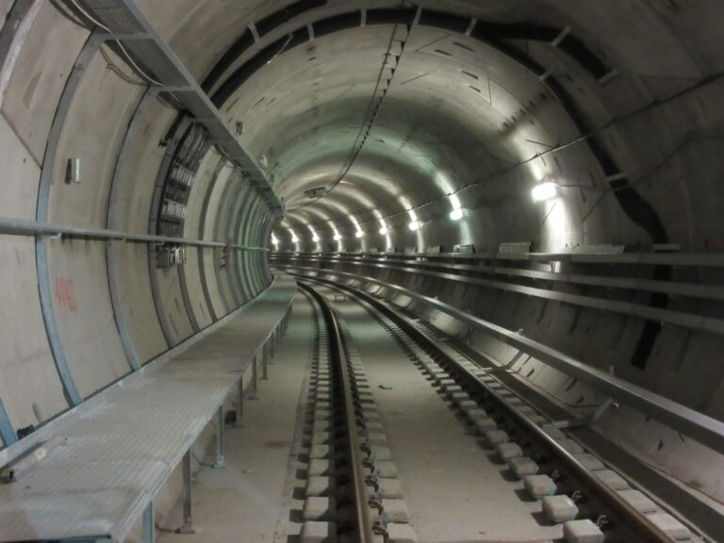
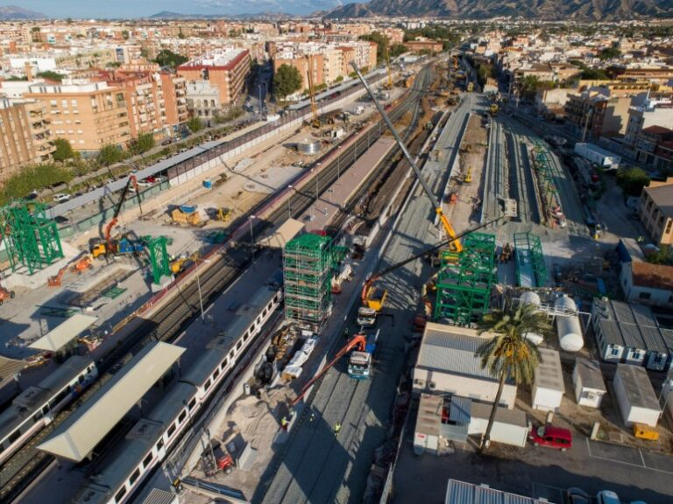
COGITO Project
Real-World Entity
Digital Entity
Austria
Denmark
Spain
Notes:
mismo tamaño, bidirectional flow entre el azul y el morado sin el texto, poner bandera del país

Slide 6
COGITO Project
Real-World Entity
Digital Entity
DT Data *
Entity *
DT Connections *
DT Services *
Austria
Denmark
Spain
* Tao, F., Zhang, M., Liu, Y., & Nee, A. Y. (2018). Digital twin driven prognostics and health management for complex equipment. Cirp Annals, 67(1), 169-172.
VirtualEntity *
Notes:
añadir referencia a la slide 3, hacer imágenes más grandes

Slide 7

COGITO WoTDT Ontology
WoTDT ontology has been developed in the COGITO project to describe the 5 dimensions of a DTw and its features extending WoT.
WoTDT in DTws allows to:
Conceptualise the five-dimensional model architecture and its features
Describe services of different dimensions
Discover services across dimensions
Define the security specification of each dimension
Facilitates data accessibility of a specific dimension
Promotes data interoperability in all dimensions
Provide direct access to all DT functionalities
* González-Gerpe, S., Cimmino, A., Bernardos, S., Poveda-Villalón, M., García-Castro, R. (2024). WoTDT: an Extension of the WoT Thing Description Ontology for Digital Twins in the Construction Domain. (publishing process)
Notes:
en cogito se ha propuesto una onto que describe las 5 capas y todas sus features extendiendo WoT, referencia a nuestro paper (título, autores y LDAC conference (publishing process)), Para qué quiero la ontología

Slide 8
COGITO WoTDT Ontology
WoTDT ontology has been developed in the COGITO project to describe the 5 dimensions of a DTw and its features extending WoT.
WoTDT in DTws allows to:
Conceptualise the five-dimensional model architecture and its features
Describe services of different dimensions
Discover services across dimensions
Define the security specification of each dimension
Facilitates data accessibility of a specific dimension
Promotes data interoperability in all dimensions
Provide direct access to all DT functionalities
WoT TD
* González-Gerpe, S., Cimmino, A., Bernardos, S., Poveda-Villalón, M., García-Castro, R. (2024). WoTDT: an Extension of the WoT Thing Description Ontology for Digital Twins in the Construction Domain. (publishing process)
Notes:
en cogito se ha propuesto una onto que describe las 5 capas y todas sus features extendiendo WoT, referencia a nuestro paper (título, autores y LDAC conference (publishing process)), Para qué quiero la ontología

Slide 9
COGITO WoTDT Ontology
WoTDT ontology has been developed in the COGITO project to describe the 5 dimensions of a DTw and its features extending WoT.
WoTDT in DTws allows to:
Conceptualise the five-dimensional model architecture and its features
Describe services of different dimensions
Discover services across dimensions
Define the security specification of each dimension
Facilitates data accessibility of a specific dimension
Promotes data interoperability in all dimensions
Provide direct access to all DT functionalities
WoT Discovery
WoT TD
* González-Gerpe, S., Cimmino, A., Bernardos, S., Poveda-Villalón, M., García-Castro, R. (2024). WoTDT: an Extension of the WoT Thing Description Ontology for Digital Twins in the Construction Domain. (publishing process)
Notes:
en cogito se ha propuesto una onto que describe las 5 capas y todas sus features extendiendo WoT, referencia a nuestro paper (título, autores y LDAC conference (publishing process)), Para qué quiero la ontología

Slide 10
COGITO WoTDT Ontology
WoTDT ontology has been developed in the COGITO project to describe the 5 dimensions of a DTw and its features extending WoT.
WoTDT in DTws allows to:
Conceptualise the five-dimensional model architecture and its features
Describe services of different dimensions
Discover services across dimensions
Define the security specification of each dimension
Facilitates data accessibility of a specific dimension
Promotes data interoperability in all dimensions
Provide direct access to all DT functionalities
WoT Discovery
WoT TD
* González-Gerpe, S., Cimmino, A., Bernardos, S., Poveda-Villalón, M., García-Castro, R. (2024). WoTDT: an Extension of the WoT Thing Description Ontology for Digital Twins in the Construction Domain. (publishing process)
Notes:
en cogito se ha propuesto una onto que describe las 5 capas y todas sus features extendiendo WoT, referencia a nuestro paper (título, autores y LDAC conference (publishing process)), Para qué quiero la ontología

Slide 11
COGITO WoTDT Ontology
WoTDT ontology has been developed in the COGITO project to describe the 5 dimensions of a DTw and its features extending WoT.
WoTDT in DTws allows to:
Conceptualise the five-dimensional model architecture and its features
Describe services of different dimensions
Discover services across dimensions
Define the security specification of each dimension
Facilitates data accessibility of a specific dimension
Promotes data interoperability in all dimensions
Provide direct access to all DT functionalities
WoT Discovery
WoT TD
* González-Gerpe, S., Cimmino, A., Bernardos, S., Poveda-Villalón, M., García-Castro, R. (2024). WoTDT: an Extension of the WoT Thing Description Ontology for Digital Twins in the Construction Domain. (publishing process)
Notes:
en cogito se ha propuesto una onto que describe las 5 capas y todas sus features extendiendo WoT, referencia a nuestro paper (título, autores y LDAC conference (publishing process)), Para qué quiero la ontología

Slide 12
WoT Digital Twin Model
DT Data *
Entity *
DT Connections *
DT Services *
Austria
Denmark
Spain
VirtualEntity *
Notes:
añadir referencia a la slide 3, hacer imágenes más grandes

Slide 13
WoT Digital Twin Model
DT Data *
Entity *
WoTDT
DT Connections *
WoTDT
DT Services *
Austria
Denmark
Spain
VirtualEntity *
WoTDT
Notes:
añadir referencia a la slide 3, hacer imágenes más grandes

Slide 14
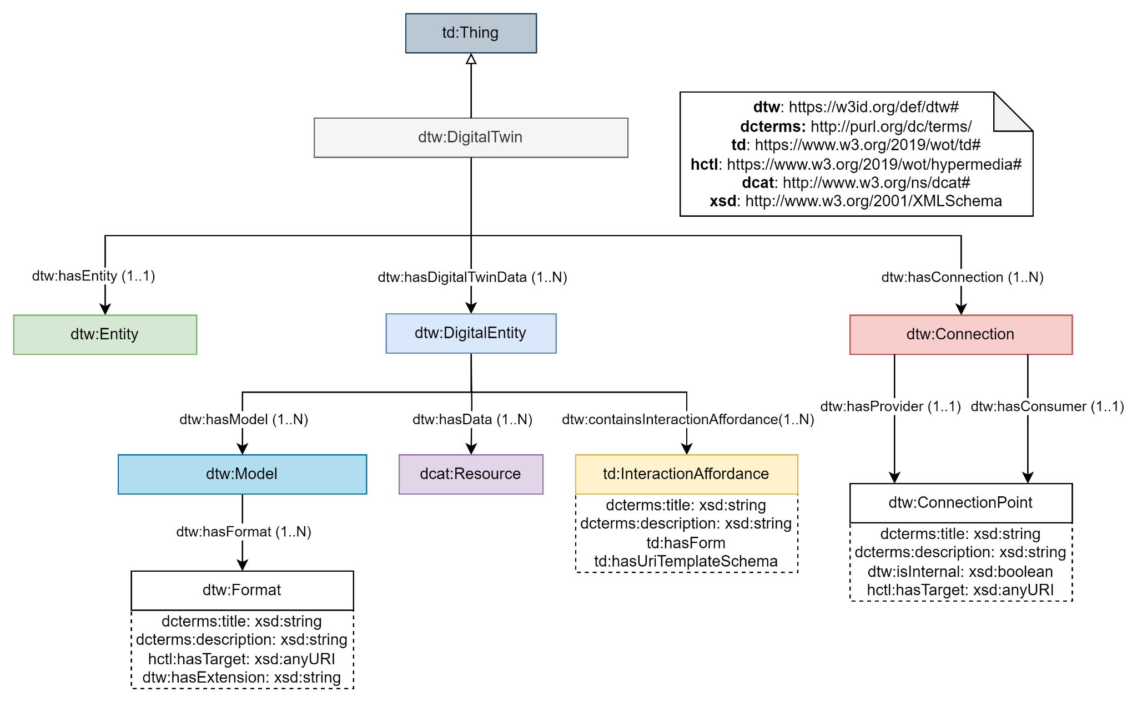
WoTDT Ontology
Entity
DT Connections
VirtualEntity
DT Data
DT Services
Notes:
poner los mismos colores y añadir bocadillos de las dimensiones

Slide 15
WoTDT Context
{ "@context": [
# Ontology URIs "https://www.w3.org/2019/wot/td/v1", "https://raw.githubusercontent.com/Salva5297/SemanticDT_TD/main/context/dt.td.context.jsonld", "https://w3c.github.io/wot-discovery/context/discovery-core.jsonld",
# Namespaces for data
{ "element": "https://data.cogito.iot.linkeddata.es/resources/element/", "sdt": "https://data.cogito.iot.linkeddata.es/resources/sdt/", "dt_ve": "https://data.cogito.iot.linkeddata.es/resources/ve/", "dt_dd": "https://data.cogito.iot.linkeddata.es/resources/dd/" }, ],
…
}

Slide 16
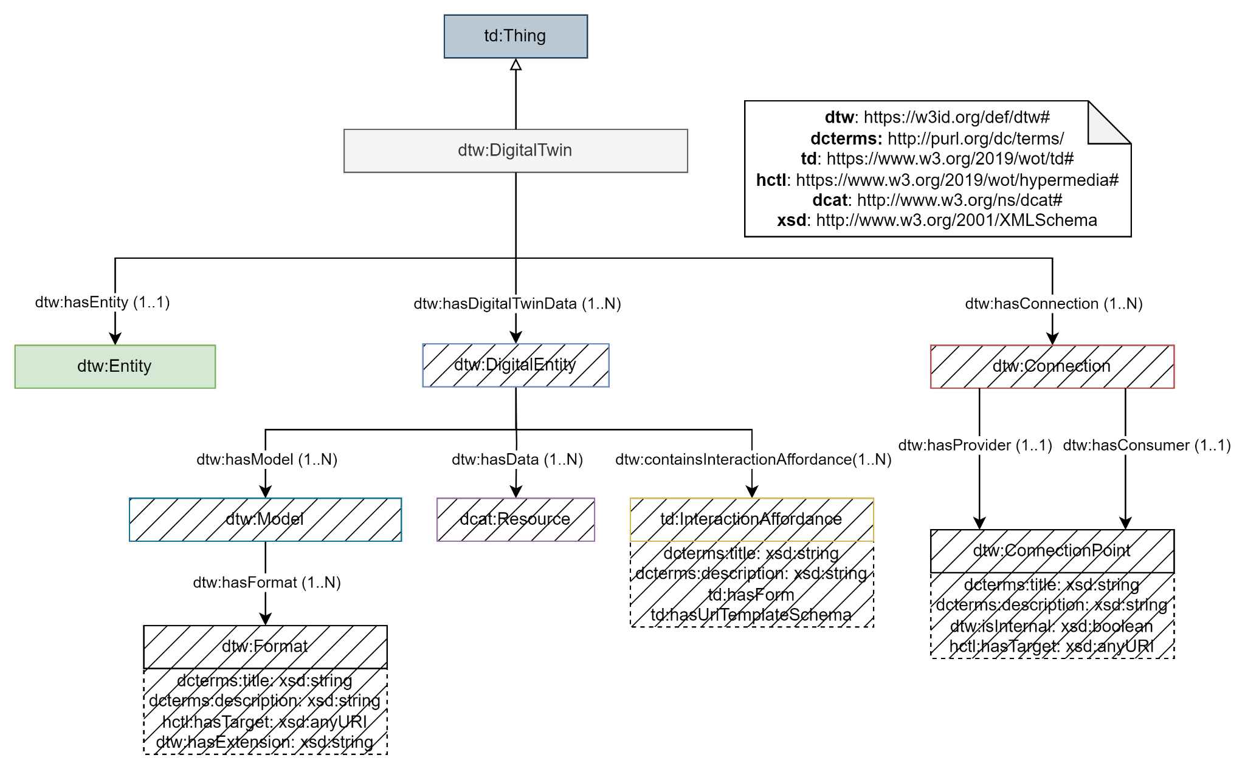
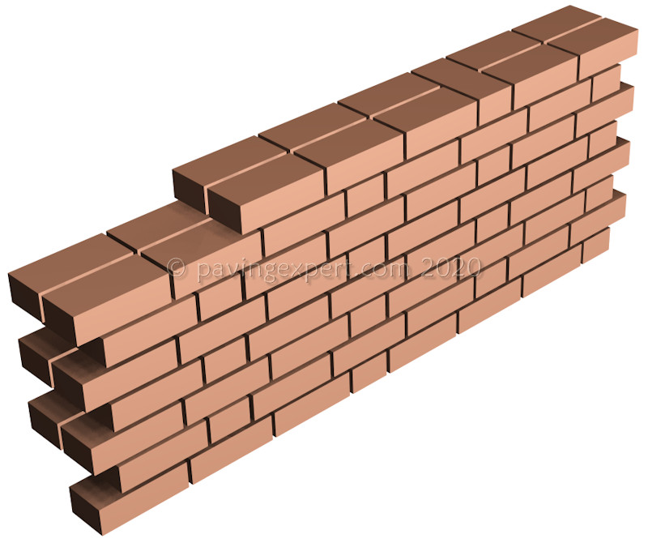
WoTDT Entity
Entity
{
"@context": [...],
"id": "sdt:01U2O",
"@type": "DigitalTwin",
"title": "Element 10486",
"entity": "element:10486",
…

Slide 17
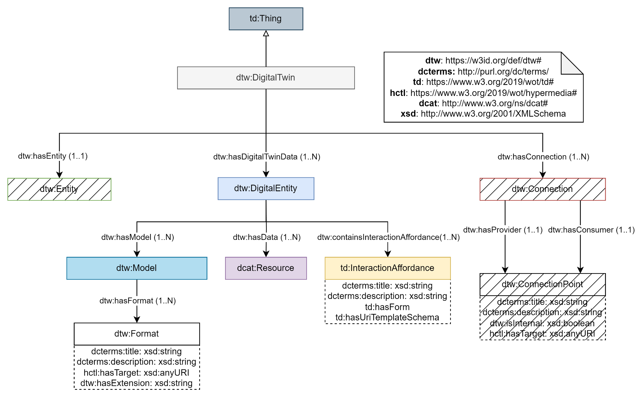
Digital Entity
VirtualEntity

Slide 18
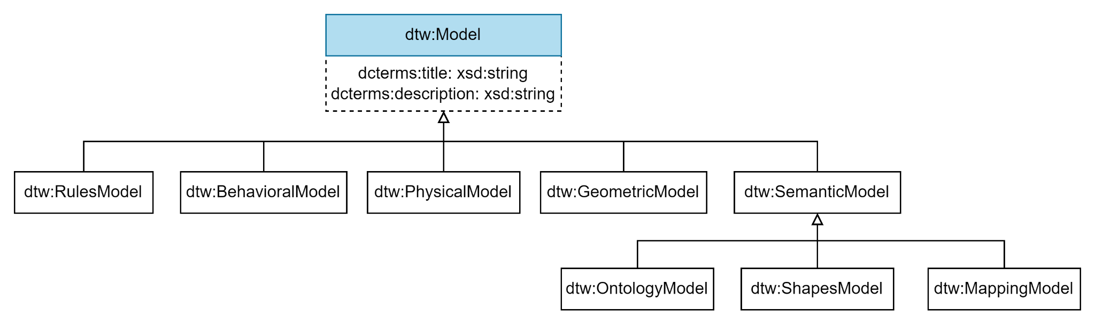
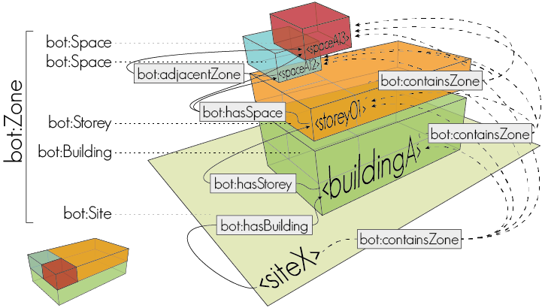
Virtual Entity Models

Slide 19
DTw Thing Description Extension Digital Entity - Models
"digital_entity": [ { "id": "dt_ve:7d6e5", "type": "Digital Entity", "title": "Digital Entity", "description": "Digital Entity of DTw 01U2O from project 308736f9-f533-4b4b-9a49-14b5363690db", "models": [ { "type": "Ontology_Model", "title": "Building Element Ontology", "description": "The Building Element Ontology provides an ontology based on the IfcBuildingElement subtree in the IFC specification, containing a taxonomy of classes that allow to define common building elements.", "formats": [ {
"id": "format:fea24", "type": "Format", "title": "JSON-LD", "description": "JSON-LD format.", "href": "https://pi.pauwel.be/voc/buildingelement/ontology.json", "extension": "json" }, {
"id": "format:ca7ea", "type": "Format", "title": "RDF/XML", "description": "RDF/XML Format.", "href": "https://pi.pauwel.be/voc/buildingelement/ontology.xml", "extension": "xml" },
…
Digital Entity Metadata
Models
Formats

Slide 20
Digital Entity
DT Data

Slide 21
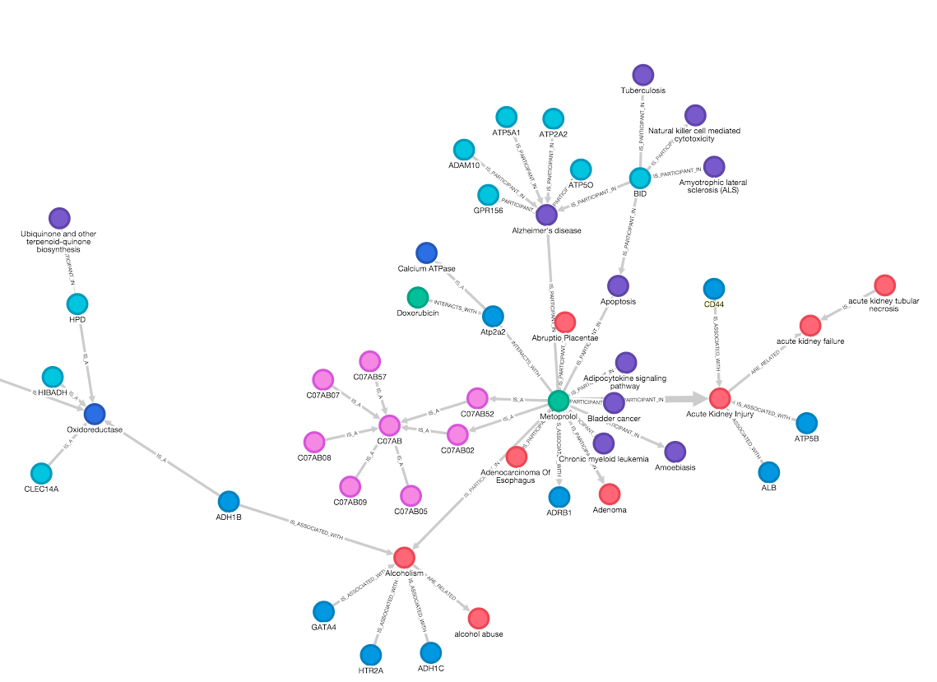
DTw Thing Description Extension Digital Entity - Data
dcat:Resource
"data": [
{
"id": "dt_dd:f538c",
"type": "dcat:Dataset",
"title": "Knowledge Graph",
"description": "Knowledge Graph of SDT 01U2O from project 308736f9-f533-4b4b-9a49-14b5363690db.",
"distribution:abae0": {
"type": "dcat:Distribution",
"dcat:accessURL": "https://triplestore.cogito.iot.linkeddata.es/resource?uri=https:%2F%2Fdata.cogito.iot.linkeddata.es%2F308736f9-f533-4b4b-9a49-14b5363690db&role=context",
"dcat:mediaType": "application/sparql-results+json",
"dcat:downloadURL": "https://triplestore.cogito.iot.linkeddata.es/repositories/cogito-triplestore/statements?infer=false&context=%3Chttps%3A%2F%2Fdata.cogito.iot.linkeddata.es%2F308736f9-f533-4b4b-9a49-14b5363690db%3E&location=&Accept=text%2Fturtle",
"data_service:f1526": {
"type": "dcat:DataService",
"dcat:endpointURL": "https://triplestore.cogito.iot.linkeddata.es/repositories/cogito-triplestore",
"dcat:endpointDescription": "SPARQL endpoint of the Triplestore where the Knowledge Graph is stored."
}
}
},
…

Slide 22
Digital Entity
DT Services

Slide 23

DTw Thing Description Extension Digital Entity - Services
"services": [
"properties": {
"validate_rdf": {
"forms": [{
"href": "https://data.cogito.iot.linkeddata.es/validation/api/validate_rdf/data",
"type": "text/turtle"
}]
}
},
"actions": {
"register_shacl_model": {
"forms": [{
"href": "https://data.cogito.iot.linkeddata.es/validation/api/rdf_shacl/mapping",
"type": "application/octet-stream"
}]
}
},
"events": {}
},
…
td:InteractionAffordance

Slide 24
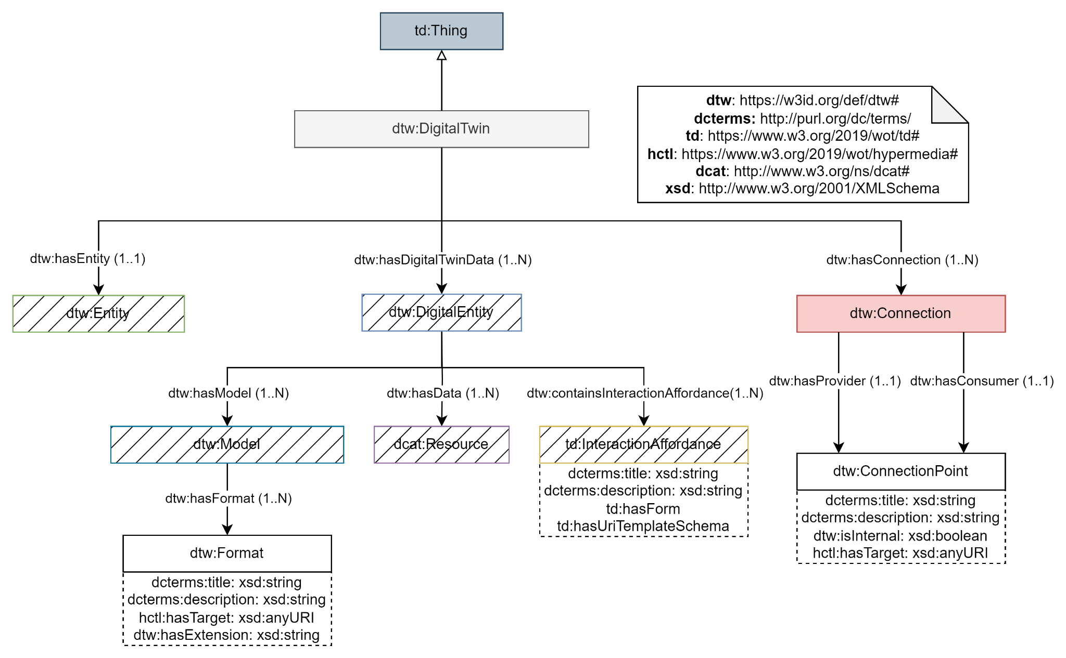
Connections
DT Connections

Slide 25
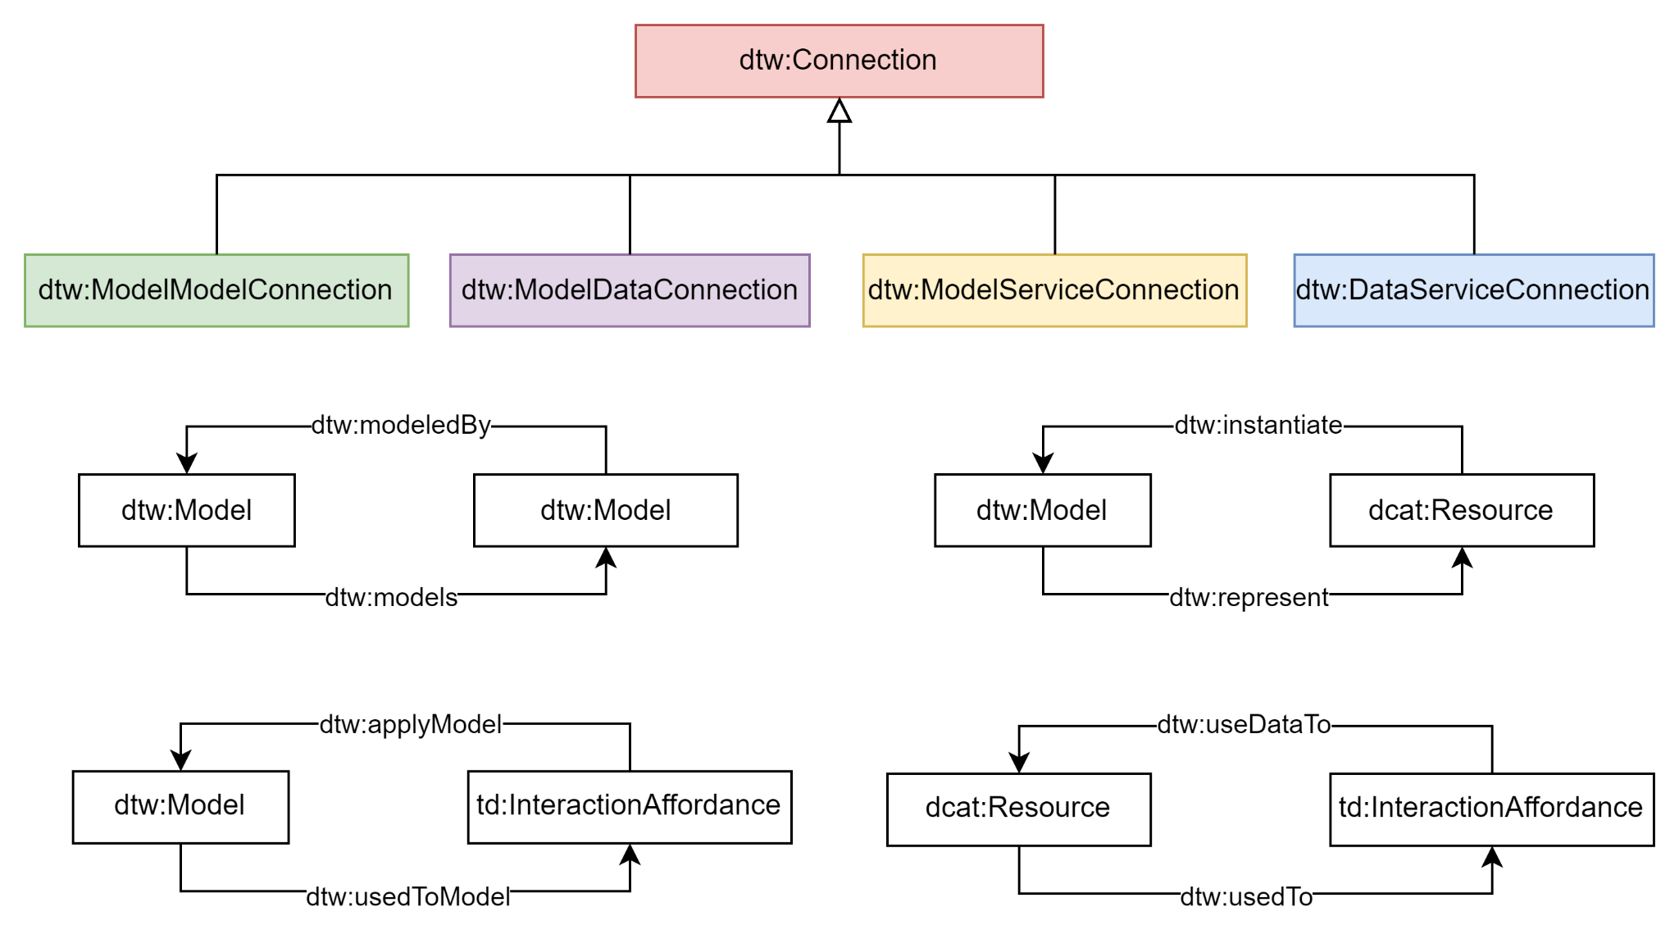
Type of Connections

Slide 26
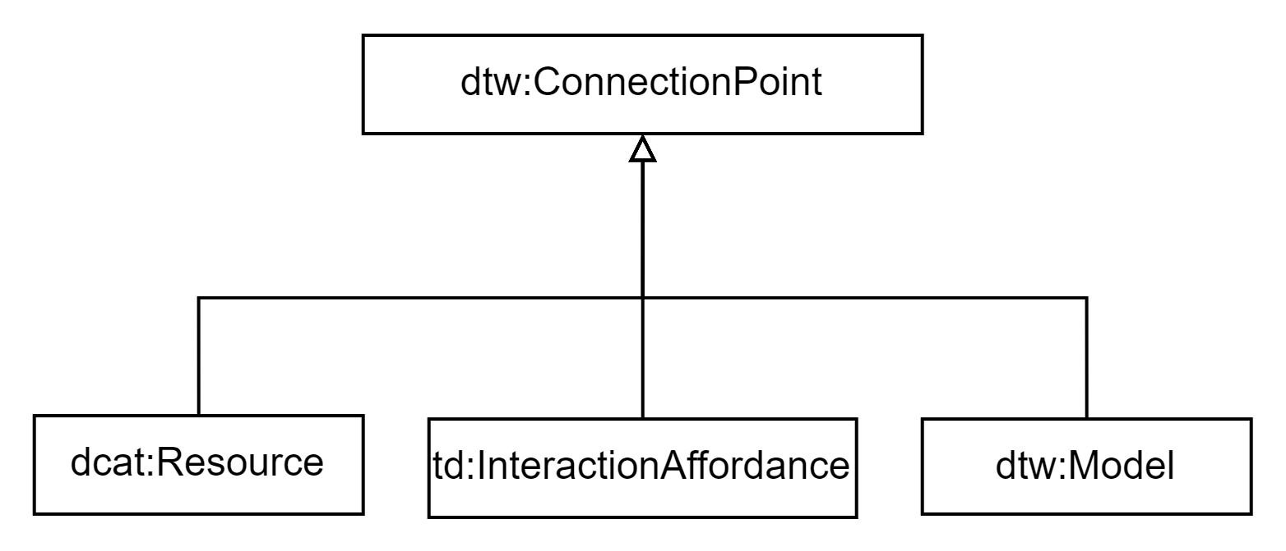
Type of Connection Points

Slide 27
DTw Thing Description Extension Connections
"connections": [
"dt_cn:190d0" : {
"type": "Data_Service", "title": "Materialization connection.",
"consumer": { "type": "DTw_Service", "title": "Helio", "description": "Materialization service used to generate RDF data.", "href": "https://data.cogito.iot.linkeddata.es/validation/api/project_to_rdf/data", "internal": "true"
},
"provider": { "type": "dcat:Dataset", "title": "IFC File", "description": "IFC File of SDT 01U2O from project 308736f9-f533-4b4b-9a49-14b5363690db.", "href": "https://dtp.cogito-project.com/file/508bfae6-dada-46d1-8d40-beb18c1619b8/download", "internal": "false"
} },
… ],
…
Connection
Connection Points

Slide 28
DTw Thing Description Extension Connections
"connections": [
"dt_cn:190d0" : {
"type": "Data_Service", "title": "Materialization connection.",
"consumer": { "type": "DTw_Service", "title": "Helio", "description": "Materialization service used to generate RDF data.", "href": "https://data.cogito.iot.linkeddata.es/validation/api/project_to_rdf/data", "internal": "true"
},
"provider": { "type": "dcat:Dataset", "title": "IFC File", "description": "IFC File of SDT 01U2O from project 308736f9-f533-4b4b-9a49-14b5363690db.", "href": "https://dtp.cogito-project.com/file/508bfae6-dada-46d1-8d40-beb18c1619b8/download", "internal": "false"
} },
… ],
…
Connection
Connection Points

Slide 29
Challenges on reusing WoT
The usage of WoT in COGITO has been a challenge due to:
The lack of conceptualization to represent DT dimensions.
The lack of conceptualization to represent some DT dimension features.
The lack of representation of the connections between DT dimensions and dimension features
Notes:
problemas con adaptar wot en los dt, problema con los conectores de las conexiones, lo que me ha costado a mi, que no me servía de WoT y lo que si me servía

Slide 30
Conclusions
WoTDT ontology is developed as an extension of TD ontology to describe the five-dimensional architecture approach of DTws.
Thanks to WoT, this ontology enables a more precise comprehension of the DTws and provides direct access to all the system functionalities.
Despite being initially designed for the construction domain, the ontology is flexible enough to incorporate new classes and subclasses to the different dimensions, to cover other domains.

Slide 31

Future Challenge
Aggregation of DTws to create an ecosystem of DTws
An aggregation of DTws consists on combine two DTws in order to provide benefits of one DTw to the other one linked.
An ecosystem of DTws can be created within the combination of different DTws in order to generate a DTw composed of multiple DTws.
How two DTws can be combined?
How WoT can help at this aggregation?
ANY IDEAS?
DTw₁
DTw₂
Notes:
cambiar la palabra connect por una que lo explique mejor

Slide 32
Future Challenge
Aggregation of DTws to create an ecosystem of DTws
An aggregation of DTws consists on combine two DTws in order to provide benefits of one DTw to the other one linked.
An ecosystem of DTws can be created within the combination of different DTws in order to generate a DTw composed of multiple DTws.
How two DTws can be combined?
How WoT can help at this aggregation?
ANY IDEAS?
DTw_{A}
DTw₁
DTw₂
Notes:
cambiar la palabra connect por una que lo explique mejor

Slide 33

Q & A
Many Thanks!
Salvador González-Gerpe, Andrea Cimmino and Raúl García-Castro
salvador.gonzalez.gerpe@upm.es

Slide 34
WoT Meetup
WoT Digital Twin Ontology (WoTDT)
Ontology Engineering Group,
Universidad Politécnica de Madrid
Salvador González-Gerpe, Andrea Cimmino,
Raúl García-Castro
salvador.gonzalez.gerpe@upm.es
05/2024
Notes:
Representing Digital Twins and their information resources with WoT

